Slide 1
Warm Up
What age range is eligible for the civilian labor force?
What groups of people are not counted in unemployment?
What is structural unemployment? Frictional? Cyclical? Seasonal? Technological?
What is an external shock?
What were two causes of the Great Depression?
What officially got the United States out of the Great Depression?

Slide 2
Chapter 16

Slide 3
The Cost of economic instability
Stagflation – A period of stagnant growth combined with inflation
GDP Gap – The difference between the actual GDP and the potential GDP that could be produced if all resources were fully employed
Misery Index – The sum of the monthly inflation and unemployment rates
  Also known as the discomfort index
Uncertainty – When the economy is unstable people are less likely to spend money
Wasted Resources – Human labor unused during unemployment or factories that remain idle

Slide 4
The Cost of economic instability
Political Instability – When the economy is bad voters get angry and the incumbents are usually voted out of office
Crime – Tends to increase during bad economic times and decrease during good economic times

Slide 5
Macroeconomic equilibrium
Aggregate Supply – The total value of goods and services that all firms would produce in a specific period of time at various price levels
Aggregate Demand – The total quantity of goods and services demanded at different price levels
Macroeconomic equilibrium – The level of real GDP consistent with a given price level

Slide 6
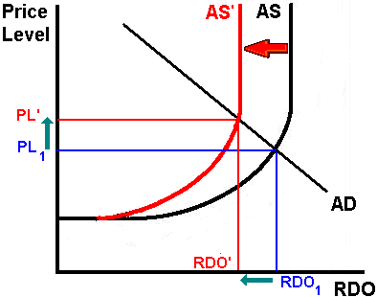
Macroeconomic equilibrium

Slide 7
Warm UP
The Civilian Labor Force (CLF) is 845,550. The number of people unemployed is 50,790. What is the unemployment rate?
A stock was purchased for $47.66. Four months later the stock was sold for $45.83. What was the percent change?
  Consumer Spending = $9,000,000
  Exports = $2,000,000
  Government Spending = $8,000,000
  Investment Spending = $7,000,000
  Imports = $4,000,000
  What is the GDP of this nation?
What is the difference between GDP and GNP? What is the difference between Real GDP and Nominal GDP? Which one is a better representation of a country’s wealth?

Slide 8
Stabilization policies
Fiscal Policy – The federal government’s attempt to stabilize the economy through taxing and government spending
Keynesian Economics (Demand Side Economics) – A set of actions designed to lower unemployment by stimulating aggregate demand
Remember this equation GDP = C + I + G + (X – M)
  Keynes argued that (X-M) was too small to worry about
  (G) was the most important stimulation to the economy
  (C) was the most stable of all
  (I) was to blame for instability
  Keynes argued that not only was (I) unstable it affected all other spending
  Keynes also argued that it was the government’s role to stabilize the economy

Slide 9
Stabilization policies
Multiplier – When a change in (I) affects (C), (G) and (X-M)
Accelerator – the change in investment spending caused by a change in total spending
Automatic Stabilizers – Programs that automatically trigger benefits if changes in the economy threaten income
  Unemployment Insurance – Insurance for workers who lose their job through no fault of their own
  Federal Entitlement Programs – Welfare, Medicaid, etc.
  Progressive Income Tax – Tax the rich more than the poor

Slide 10
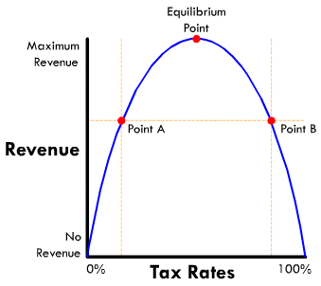
Stabilization policies
Supply-Side Economics – Policies designed to stimulate output and lower unemployment by increasing production rather than demand
Laffer Curve

Slide 11
Stabilization policies
Supply Side Economics – Government should have a reduced role in economics and that taxes should be reduced to relieve the burden on individuals and businesses
Reaganomics – Another name for supply side economics
Limitations of Supply-Side Policies
  Hasn’t seen a lot of experience
  Collects less taxation
  More for promoting growth than to remedy instability

Slide 12
Stabilization policies
Monetarism – fluctuations in the money supply can be a destabilizing element that leads to unemployment and inflation
Wage-Price Controls – Regulations that make it illegal for businesses to give workers raises or to raise prices without the explicit permission of the government
  When this was attempted it did not control inflation
  Increasing the money supply is only a short term solution to unemployment that actually causes big long term problems

Slide 13
Economics and Politics
Discretionary Fiscal Policy – Someone must choose to implement
Passive Fiscal Policy – Does not require new or special action to take place
Structural Fiscal Policy – Plans and programs put into place to strengthen the economy
The Decline of Discretionary Fiscal Policy
  Recognition Lag - The time between the beginning of the recession or inflationary period up to the awareness actually happening
  Implementation Lag – The time in which it takes to put fiscal policy into action
  Recessions tend to be short so little action is taken
  Bipartisanship rarely exists anymore – Federal Budgets can’t be agreed upon

Slide 14
The Importance of Passive Fiscal Policies
  Automatic Stabilizers – Unemployment, Social Security, etc.
Structural Fiscal Policies – Usually designed to strengthen the economy in the long run
  Health Care, Welfare, Assistance for the needy
Most Fiscal policy has been dominated by the Federal Reserve in recent years

Slide 15
All Content Created by DJ Cook

